Slide 1

IoT NETWORK ARCHITECTURE AND DESIGN

Slide 2
“The Internet of Things (IoT) is a system of interrelated computing devices, mechanical and digital machines, objects, animals or people that are provided with unique identifiers and the ability to transfer data over a network without requiring human-to-human or human-to-computer
interaction.”

Slide 3
The Internet of Things is the concept of connecting any
device (so long as it has an on/off switch) to the Internet and to other connected devices.
The IoT is a giant network of connected things and people – all of which collect and share data about the way they are used and about the environment around them.

Slide 4
A thing in the internet of things can be a person with a heart monitor implant, a farm animal with a biochip transponder, an automobile that has built-in sensors to alert the driver when tire pressure is low or any other natural or man-made object that can be assigned an IP address and is able to transfer data over a network.

Slide 5
That includes an extraordinary number of objects of all shapes and sizes – from
smart microwaves, which automatically cook your food for the right length of time, to
self-driving cars, whose complex sensors detect objects in their path, to
wearable fitness devices that measure your heart rate and the number of steps you’ve taken that day, then use that information to suggest exercise plans tailored to you.
There are even connected footballs that can track how far and fast they are thrown and record those statistics via an app for future training purposes.

Slide 6
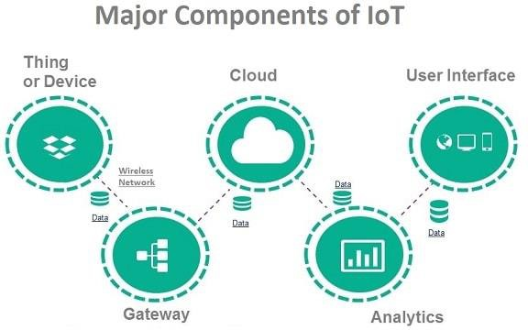

Slide 7
Application
Smart home
Wearables
Connected Cars
Smart cities
IoT in agriculture
Smart retail
IoT in healthcare
IoT in Poultry and Farming

Slide 8
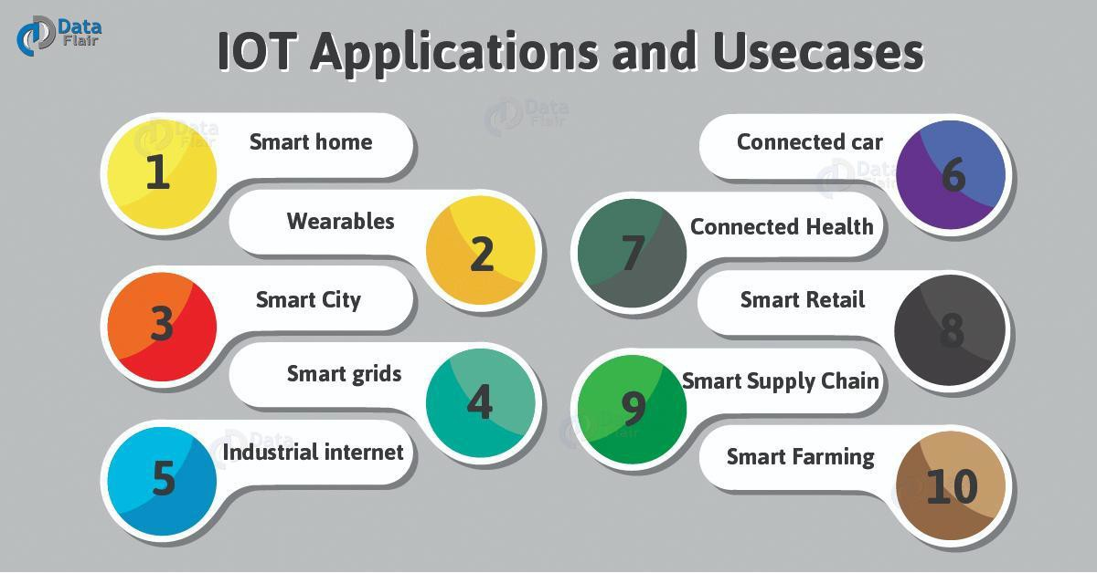

Slide 9
Scenario #1: IoT in your home
Imagine you wake up at 7am every day to go to work.Your alarm clock does the job of waking you just fine.That is, until something goes wrong.Your train’s cancelled and you have to drive to work instead.The only problem is that it takes longer to drive, and you would have needed to get up at 6.45am to avoid being late. Oh, and it’s pouring with rain, so you’ll need to drive slower than usual. A connected or IoT-enabled alarm clock would reset itself based on all these factors, to ensure you got to work on time. It could recognize that your usual train is cancelled, calculate the driving distance and travel time for your alternative route to work, check the weather and factor in slower travelling speed because of heavy rain, and calculate when it needs to wake you up so you’re not late. If it’s super-smart, if might even sync with your IoT-enabled coffee maker, to ensure your morning caffeine’s ready to go when you get up.

Slide 10
Scenario #2: IoT in transport
Having been woken by your smart alarm, you’re now driving to work. On comes the engine light.You’d rather not head
straight to the garage, but what if it’s something urgent? In a connected car, the sensor that triggered the check engine light would communicate with others in the car. A component called the diagnostic bus collects data from these
sensors and passes it to a gateway in the car, which sends the
most relevant information to the manufacturer’s platform. The manufacturer can use data from the car to offer you an appointment to get the part fixed, send you directions to the nearest dealer, and make sure the correct replacement part is ordered so it’s ready for you when you show up.

Slide 11
What is IoT?
Imagine a world where just about anything you can think of is online and communicating to other things and people in order to enable new services that enhance our lives
From self-driving drones delivering your grocery order to sensors in your clothing monitoring your health and so on
The world you know is set to undergo a major technological shift forward.
This shift is known collectively as the Internet of Things (IoT).

Slide 12
The basic premise and goal of IoT is to “connect the unconnected.”
This means that objects that are not currently joined to a computer network, namely the Internet, will be connected so that they can communicate and interact with people and other objects.
IoT is a technology transition in which devices will allow us to sense and control the physical world by making objects smarter and connecting them through an intelligent network

Slide 13
When objects and machines can be sensed and controlled remotely across a network, a tighter integration between the physical world and computers is enabled.
This allows for improvements in the areas of efficiency, accuracy, automation, and the enablement of advanced applications

Slide 14
GENESIS OF IOT
The age of IoT is often said to have started between the years 2008 and 2009
The person credited with the creation of the term “Internet of Things” is Kevin Ashton.
While working for Procter & Gamble in 1999, Kevin used this phrase to explain a new idea related to linking the
company’s supply chain to the Internet

Slide 15
“In the twentieth century, computers were brains without senses—they only knew what we told them.”
Computers depended on humans to input data and knowledge through typing, bar codes, and so on.
IoT is changing this paradigm; in the twenty-first century, computers are sensing things for themselves

Slide 16
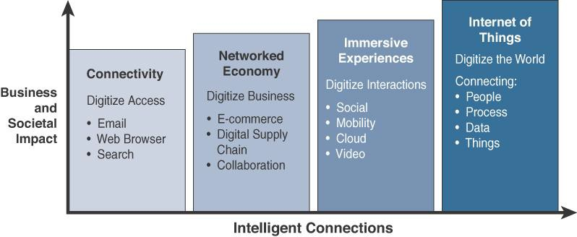
The evolution of the Internet can be categorized into four phases

Slide 17
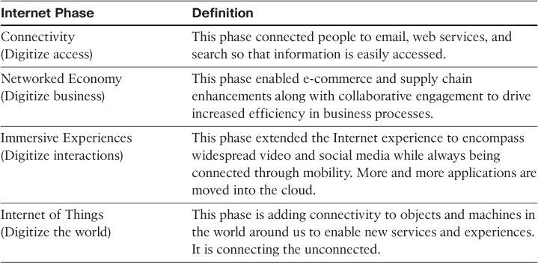

Slide 18
The first phase, Connectivity, began in the mid-1990s
In the beginning, email and getting on the Internet were luxuries
for universities and corporations.
Getting the average person online involved dial-up modems
Even though connectivity and its speed continued to improve, a saturation point was reached where connectivity was no longer the major challenge.
The focus was now on leveraging connectivity for efficiency and profit.
This inflection point marked the beginning of the second phase of the Internet evolution, called the Networked Economy

Slide 19
With the Networked Economy, e-commerce and digitally connected supply chains became the rage
Vendors and suppliers became closely interlinked with producers, and online shopping experienced incredible growth
The economy itself became more digitally intertwined as
suppliers, vendors, and consumers all became more directly connected.

Slide 20
The third phase, Immersive Experiences, is characterized by the emergence of social media, collaboration, and widespread mobility on a variety of devices
Connectivity is now pervasive, using multiple platforms from mobile phones to tablets to laptops and desktop computers.
This pervasive connectivity in turn enables communication and collaboration as well as social media across multiple channels, via email, texting, voice, and video.
In essence, person-to-person interactions have become digitized

Slide 21
IOT AND DIGITIZATION
IoT and digitization are terms that are often used interchangeably.
In most contexts, this duality is fine, but there are key differences to be aware of.
At a high level, IoT focuses on connecting “things,” such as objects and machines, to a computer network, such as the Internet. IoT is a well-understood term used across the industry as a whole
On the other hand, digitization can mean different things to different people but generally encompasses the connection of “things” with the data they generate and the business insights that result.

Slide 22
Example
In a shopping mall where Wi-Fi location tracking has been
deployed, the “things” are the Wi-Fi devices.
Wi-Fi location tracking is simply the capability of knowing where a consumer is in a retail environment through his or
her smart phone’s connection to the retailer’s Wi-Fi network.
Tracking real-time location of Wi-Fi clients provides a specific business benefit to the mall and shop owners.
In this case, it helps the business understand where shoppers tend to congregate and how much time they spend in different parts of a mall or store.
Analysis of this data can lead to significant changes to the locations of product displays and advertising, where to place certain types of shops, how much rent to charge, and even where to station security guards.

Slide 23
Digitization, as defined in its simplest form, is the conversion of information into a digital format.
For example, the whole photography industry has been digitized
The video industry
Transportation industry - Uber
In the context of IoT, digitization brings together things, data, and business process to make networked connections more relevant and valuable

Slide 24
Example
Home automation with popular products, such as Nest.
With Nest, sensors determine your desired climate settings and also tie in other smart objects, such as smoke alarms, video cameras, and various third-party devices.
In the past, these devices and the functions they perform were managed and controlled separately and could not provide the holistic experience that is now possible.

Slide 25
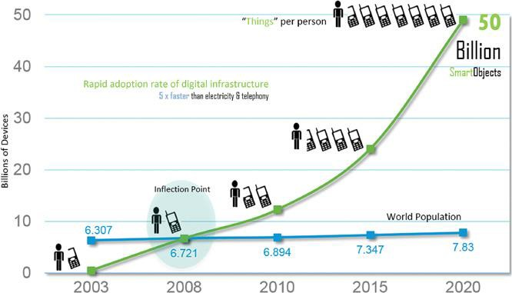
IOT IMPACT

Slide 26
Connected roadways
Connected factory
Smart Connected Buildings
Smart Creatures

Slide 27
CONVERGENCE OF IT AND OT
IT supports connections to the Internet along with related data and technology systems and is focused on the secure flow of data across an organization.
OT monitors and controls devices and processes on physical operational systems
These systems include assembly lines, utility distribution networks, production facilities, roadway systems, and many more

Slide 28
The IT organization is responsible for the information systems of a business, such as email, file and print services, databases, and so on.
OT is responsible for the devices and processes acting on industrial equipment, such as factory machines, meters, actuators, electrical distribution automation devices and so on
IT vs OT

Slide 29
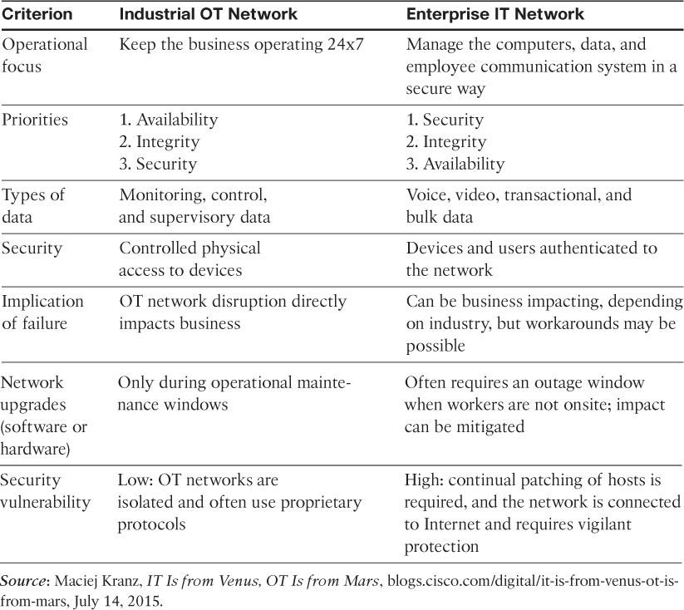

Slide 30
With the rise of IoT and standards-based protocols, such as IPv6, the IT and OT worlds are converging
OT is beginning to adopt the network protocols, technology, transport, and methods of the IT organization, and
The IT organization is beginning to support the operational requirements used by OT

Slide 31
The convergence of IT and OT to a single consolidated network poses several challenges
The OT organization is baffled when IT schedules a weekend shutdown to update software without regard to production requirements
When the IT team deploys QoS, voice and video traffic are almost universally treated with the highest level of service.
However, when the OT system shares the same network, a very strong argument can be made that the real-time OT
traffic should be given a higher priority

Slide 32
IOT CHALLENGES
Scale
Security
Privacy
Big data and data analytics
Interoperability

Slide 33
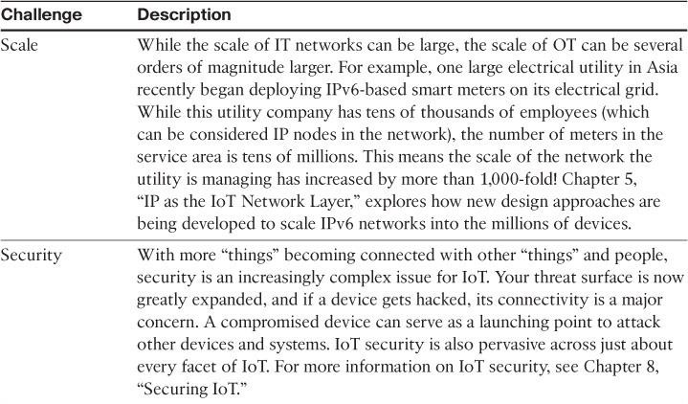

Slide 34
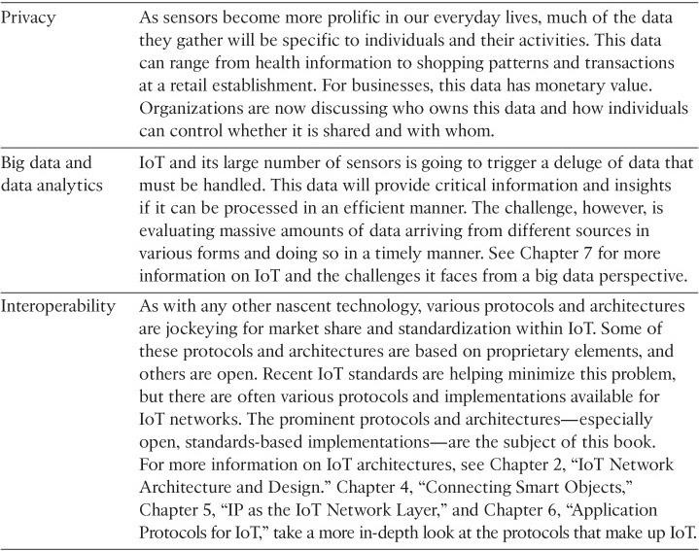

Slide 35
IoT Network Architecture and Design

Slide 36
Imagine that one day you decide to build a house
To successfully complete a construction project, time and effort are required to design each phase, from the foundation to the roof.
Your plans must include detailed designs for the electrical, plumbing, heating, and security systems

Slide 37
A computer network should be built with-- careful planning, security policies, and adherence to well-understood design practices.
Failure to meet these will likely result in something that is difficult to scale, manage, adapt to organizational changes, and, worst of all, troubleshoot when things go wrong
If the network fails, company operations can be seriously impaired

Slide 38
Just as a house must be designed with the strength to withstand potential natural disasters, such as seismic events and hurricanes,
information technology (IT) systems need to be designed to
withstand “network earthquakes,” such as
distributed denial of service (DDoS) attacks,
future growth requirements,
network outages, and
even human error

Slide 39
DRIVERS BEHIND NEW NETWORK ARCHITECTURES
Building residential houses vs building a massive stadium..
The difference between IT and IoT networks is much like the difference between residential architecture and stadium architecture
The key difference between IT and IoT is the data.
IT systems are mostly concerned with reliable and
continuous support of business applications such as email, web, databases, CRM systems, and so on.
IoT is all about the data generated by sensors and how that data is used.

Slide 40
The essence of IoT architectures thus involves how the data is transported, collected, analyzed, and ultimately acted upon

Slide 41
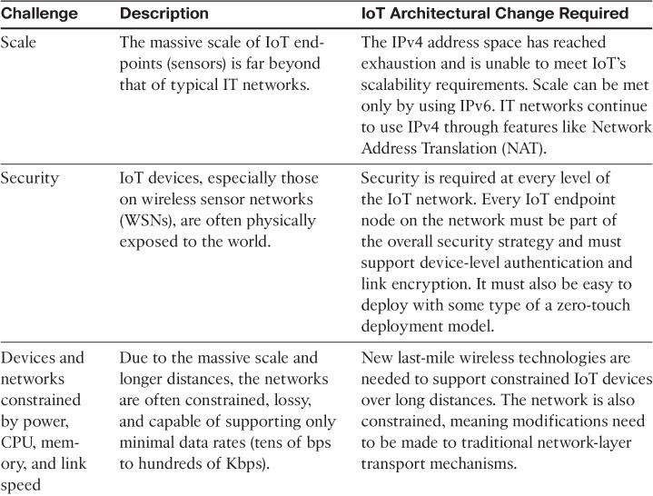

Slide 42
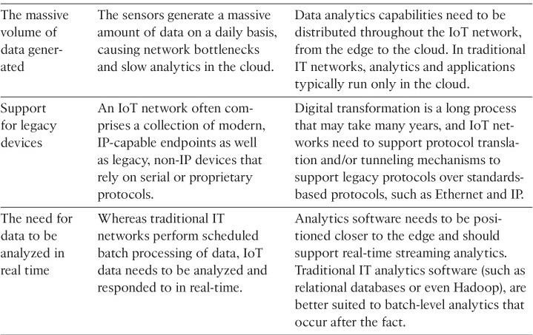

Slide 43
Security
IT networks use firewall, IT endpoints are behind firewall
IoT endpoints are often located in wireless sensor networks that use unlicensed spectrum and are not only visible to the world through a spectrum analyzer but often physically
accessible
IoT systems require consistent mechanisms of authentication, encryption, and intrusion prevention techniques

Slide 44
IoT systems must:
Be able to identify and authenticate all entities involved in the IoT service (that is, gateways, endpoint devices, home networks, roaming networks, service platforms)
Ensure that all user data shared between the endpoint device and back-end applications is encrypted
Comply with local data protection legislation so that all data is protected and stored correctly
Take network-level approach to security in addition to device level approach

Slide 45
Constrained Devices and Networks
Most IoT sensors are designed for a single job, and they are typically small and inexpensive
They often have limited power, CPU, and memory, and they transmit only when there is something important
The networks that provide connectivity also tend to be very lossy and support very low data rates.
This is a completely different situation from IT networks
IoT requires a new breed of connectivity technologies that meet both the scale and constraint limitations

Slide 46
Legacy Device Support
Supporting legacy devices in an IT organization is not usually a big problem
If someone’s computer or operating system is outdated, she
simply upgrades
If someone is using a mobile device with an outdated Wi-Fi standard, such as 802.11b or 802.11g, you can simply deny him access to the wireless network, and he will be forced to upgrade

Slide 47
In OT systems, end devices are likely to be on the network for a very long time—sometimes decades.
As IoT networks are deployed, they need to support the older devices already present on the network, as well as devices with new capabilities

Slide 48
COMPARING IOT ARCHITECTURES
oneM2M architecture
The IoT World Forum(IoTWF)

Slide 49
The oneM2M IoT Standardized Architecture
To standardize the rapidly growing field of machine-to- machine (M2M) communications, the European Telecommunications Standards Institute (ETSI) created the M2M Technical Committee in 2008
The goal of oneM2M is to create a common services layer, which can be readily embedded in field devices to allow communication with application servers
oneM2M’s framework focuses on IoT services, applications,
and platforms

Slide 50
One of the greatest challenges in designing an IoT architecture is dealing with the heterogeneity of devices, software, and access methods
By developing a horizontal platform architecture, oneM2M is developing standards that allow interoperability at all levels of the IoT stack
For example, you might want to automate your HVAC system by connecting it with wireless temperature sensors spread throughout your office

Slide 51
The problem is that the LoRaWAN network and the BACnet system that your HVAC and BMS run on are completely different systems and have no natural connection point
This is where the oneM2M common services architecture comes in.
oneM2M’s horizontal framework and RESTful APIs allow the LoRaWAN system to interface with the building management system over an IoT network, thus promoting end-to-end IoT communications in a consistent way, no matter how heterogeneous the networks

Slide 52
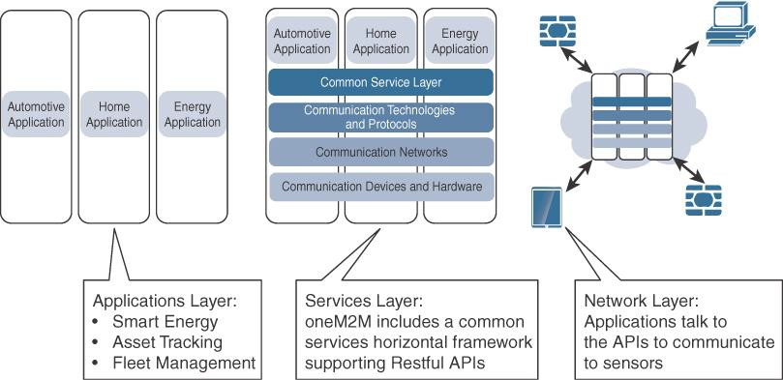
The Main Elements of the oneM2M IoT Architecture

Slide 53
Three major domains:
The application layer,
The services layer, and
The network layer

Slide 54
Application layer
The oneM2M architecture gives major attention to connectivity between devices and their applications
This domain includes the application-layer protocols and attempts to standardize northbound API definitions for interaction with business intelligence (BI) systems

Slide 55
Services layer
This layer is shown as a horizontal framework across the vertical industry applications
At this layer, horizontal modules include the physical network that the IoT applications run on, the underlying management protocols, and the hardware.
Examples include backhaul communications via cellular, MPLS networks, VPNs, and so on.
Riding on top is the common services layer.
This conceptual layer adds APIs and middleware supporting third-party services and applications

Slide 56
Network layer
This is the communication domain for the IoT devices and endpoints.
It includes the devices themselves and the communications network that links them
Communications infrastructure include wireless mesh technologies, such as IEEE 802.15.4, and wireless point-to- multipoint systems, such as IEEE 801.11ah

Slide 57
The IoT World Forum (IoTWF) Standardized Architecture
A seven-layer IoT architectural reference model published by IoTWF architectural committee ( Cisco, IBM, Rockwell Automation)
Edge computing
Data storage
Access

Slide 58
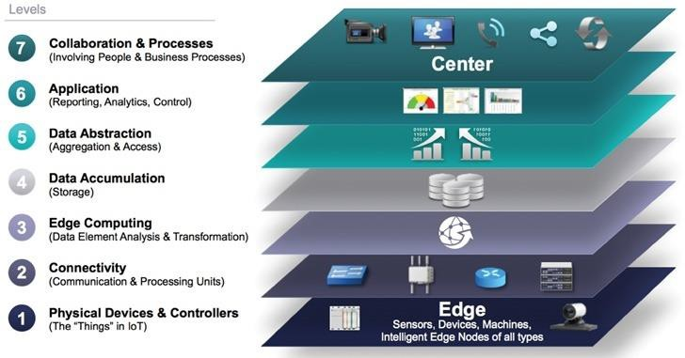
IoT Reference Model Published by the IoT World Forum

Slide 59
Using this reference model, we are able to achieve the following:
Decompose the IoT problem into smaller parts
Identify different technologies at each layer and how they relate to one another
Define a system in which different parts can be provided by different vendors
Have a process of defining interfaces that leads to interoperability
Define a tiered security model that is enforced at the transition points between levels

Slide 60
Layer 1: Physical Devices and Controllers Layer
The various endpoint devices and sensors that send and receive information
The size of these “things” can range from almost microscopic
sensors to giant machines in a factory.
Their primary function is generating data and being capable of being queried and/or controlled over a network.

Slide 61
Layer 2: Connectivity Layer
The most important function of this IoT layer is the reliable and timely transmission of data.
More specifically, this includes transmissions between Layer 1 devices and the network and between the network and information processing that occurs at Layer 3 (the edge computing layer).

Slide 62
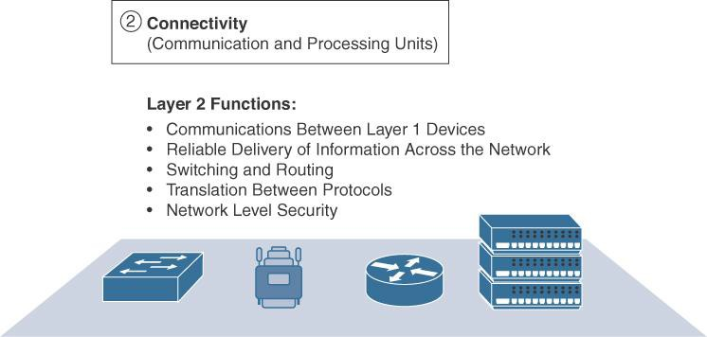

Slide 63
Layer 3: Edge Computing Layer
Fog layer
At this layer, the emphasis is on data reduction and converting network data flows into information that is ready for storage and processing by higher layers
One of the basic principles of this reference model is that information processing is initiated as early and as close to the edge of the network as possible
Another important function that occurs at Layer 3 is the
evaluation of data to see if it can be filtered or aggregated before being sent to a higher layer
This also allows for data to be reformatted or decoded, making
additional processing by other systems easier

Slide 64
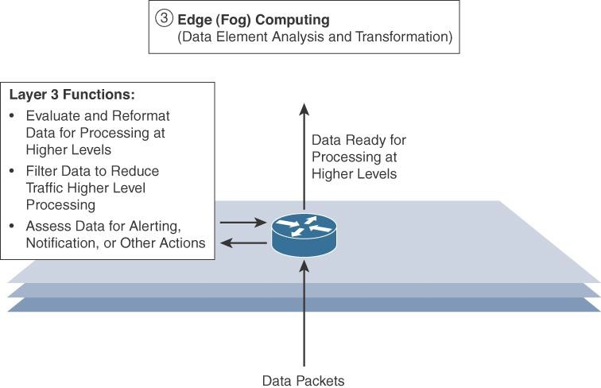

Slide 65
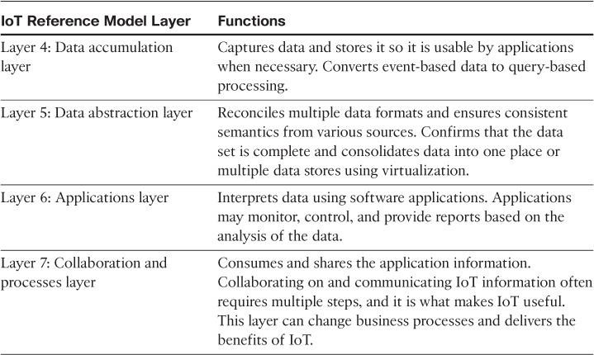
Upper Layers: Layers 4–7
The upper layers deal with handling and processing the IoT data generated by the bottom layer

Slide 66
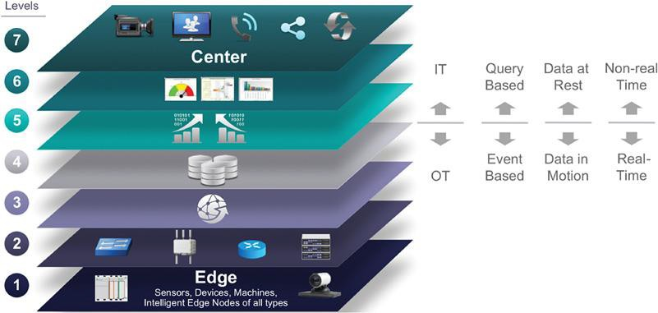
IT and OT Responsibilities in the IoT Reference Model

Slide 67
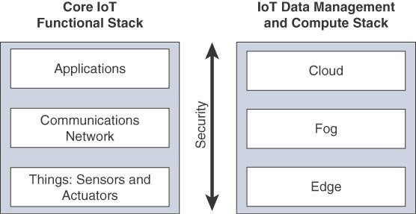
A SIMPLIFIED IOT ARCHITECTURE
The framework is presented as two parallel stacks:
The IoT Data Management and Compute Stack and
The Core IoT Functional Stack.

Slide 68
The network communications layer of the IoT stack itself involves a significant amount of detail and incorporates a vast array of technologies.
Consider for a moment the heterogeneity of IoT sensors and the many different ways that exist to connect them to a network.
The network communications layer needs to consolidate these together, offer gateway and backhaul technologies, and ultimately bring the data back to a central location for analysis and processing.

Slide 69
The network between the gateway and the data center is composed mostly of traditional technologies that experienced IT professionals would quickly recognize.
These include tunneling and VPN technologies, IP-based quality of service (QoS), conventional Layer 3 routing protocols such as BGP and IP-PIM, and security capabilities such as encryption, access control lists (ACLs), and firewalls

Slide 70
Unlike with most IT networks, the applications and analytics layer of IoT doesn’t necessarily exist only in the data center or in the cloud.
Due to the unique challenges and requirements of IoT, it is often necessary to deploy applications and data management throughout the architecture in a tiered approach, allowing data collection, analytics, and intelligent controls at multiple points in the IoT system

Slide 71
The three data management layers are
The edge layer (data management within the sensors themselves),
The fog layer (data management in the gateways and transit network), and
The cloud layer (data management in the cloud or central data center).

Slide 72
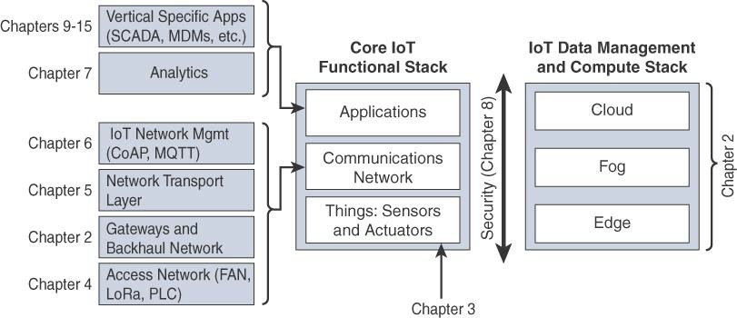
Expanded View of the Simplified IoT Architecture

Slide 73
THE CORE IOT FUNCTIONAL STACK
IoT networks are built around the concept of “things,” or smart objects performing functions and delivering new connected services.
These objects are “smart” because they use a combination of contextual information and configured goals to perform actions
These actions can be self-contained (that is, the smart object does not rely on external systems for its actions); however, in most cases, the “thing” interacts with an external system to report information that the smart object collects, to exchange with other objects, or to interact with a management platform

Slide 74
From an architectural standpoint, several components have to work together for an IoT network to be operational:
“Things” layer:
At this layer, the physical devices need to fit the constraints of the environment in which they are deployed while still being able to provide the information needed.
Communications network layer:
When smart objects are not self-contained, they need to communicate with an external system.
In many cases, this communication uses a wireless technology.
This layer has four sublayers:

Slide 75
Access network sub layer:
This is typically made up of wireless technologies such as 802.11ah, 802.15.4g, and LoRa.
The sensors connected to the access network may also be wired.

Slide 76
Gateways and backhaul network sub layer:
The gateway communicates directly with the smart objects.
The role of the gateway is to forward the collected information through a longer-range medium (called the backhaul) to a headend central station where the information is processed
Network transport sub layer:
For communication to be successful, network and transport layer protocols such as IP and UDP must be implemented to support the variety of devices to connect and media to use

Slide 77
IoT network management sub layer:
Additional protocols must be in place to allow the headend applications to exchange data with the sensors.
Examples include CoAP and MQTT.

Slide 78
Application and analytics layer:
At the upper layer, an application needs to process the collected data,
To control the smart objects when necessary,
To make intelligent decision based on the information
collected and, in turn, instruct the “things” or other systems to adapt to the analyzed conditions and change their behaviors or parameters.

Slide 79
Layer 1: Things: Sensors and Actuators Layer
Battery-powered or power-connected
Mobile or static
Low or high reporting frequency
Simple or rich data
Report range
Object density per cell

Slide 80
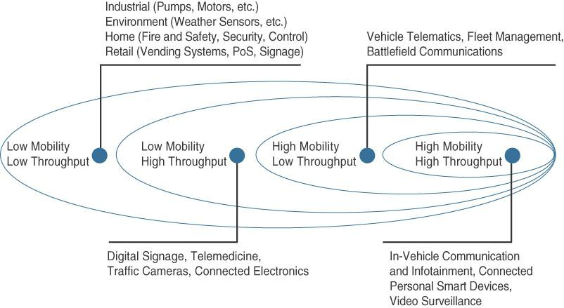

Slide 81
Layer 3: Applications and Analytics Layer
Once connected to a network, your smart objects exchange information with other systems
Analytics Versus Control Applications
Analytics application:
This type of application collects data from multiple smart objects, processes the collected data, and displays information resulting from the data that was processed
The important aspect is that the application processes the data to convey a view of the network that cannot be obtained from solely looking at the information displayed by a single
smart object.

Slide 82
Control application:
This type of application controls the behavior of the smart object or the behavior of an object related to the smart object.
For example, a pressure sensor may be connected to a pump. A control application increases the pump speed when the connected sensor detects a drop in pressure.
Control applications are very useful for controlling complex aspects of an IoT network with a logic that cannot be programmed inside a single IoT object

Slide 83
Data Versus Network Analytics
Data analytics:
This type of analytics processes the data collected by smart objects and combines it to provide an intelligent view related to the IoT system.
At a very basic level, a dashboard can display an alarm when a weight sensor detects that a shelf is empty in a store
In a more complex case, temperature, pressure, wind, humidity, and light levels collected from thousands of sensors may be combined and then processed to determine the likelihood of a storm and its possible path

Slide 84
Network analytics:
Most IoT systems are built around smart objects connected to the network.
A loss or degradation in connectivity is likely to affect the efficiency of the system. Such a loss can have dramatic effects.

Slide 85
IOT DATA MANAGEMENT AND COMPUTE STACK
The data generated by IoT sensors is one of the single biggest challenges in building an IoT system
In sensor networks, the vast majority of data generated is unstructured and of very little use on its own
In most cases, the processing location is outside the smart object.
A natural location for this processing activity is the cloud.
Smart objects need to connect to the cloud, and data processing is centralized
One advantage of this model is simplicity

Slide 86
Limitations
As data volume, the variety of objects connecting to the network, and the need for more efficiency increase, new requirements appear, and those requirements tend to bring the need for data analysis closer to the IoT system
Minimizing latency
Conserving network bandwidth
Increasing local efficiency

Slide 87
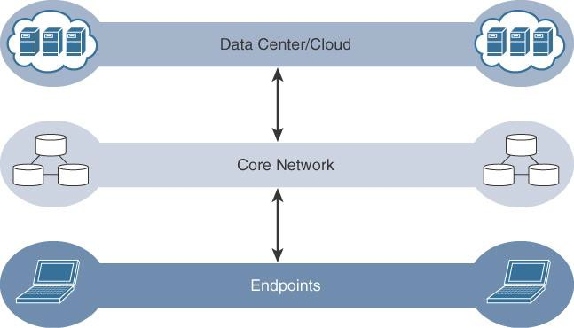
Data management in traditional IT systems

Slide 88
IoT issues to be addressed
Bandwidth in last-mile IoT networks is very limited
Latency can be very high
Network backhaul from the gateway can be unreliable and often depends on 3G/LTE or even satellite links
The volume of data transmitted over the backhaul can be high
Big data is getting bigger

Slide 89
Fog Computing
The solution to the challenges mentioned in the previous
section is to distribute data management throughout the IoT system, as close to the edge of the IP network as possible
Any device with computing, storage, and network connectivity can be a fog node.
Examples include industrial controllers, switches, routers, embedded servers, and IoT gateways.
Analyzing IoT data close to where it is collected minimizes latency, offloads gigabytes of network traffic from the core network, and keeps sensitive data inside the local network.

Slide 90
An advantage of this structure is that the fog node allows intelligence gathering (such as analytics) and control from the closest possible point, and in doing so, it allows better performance over constrained networks

Slide 91
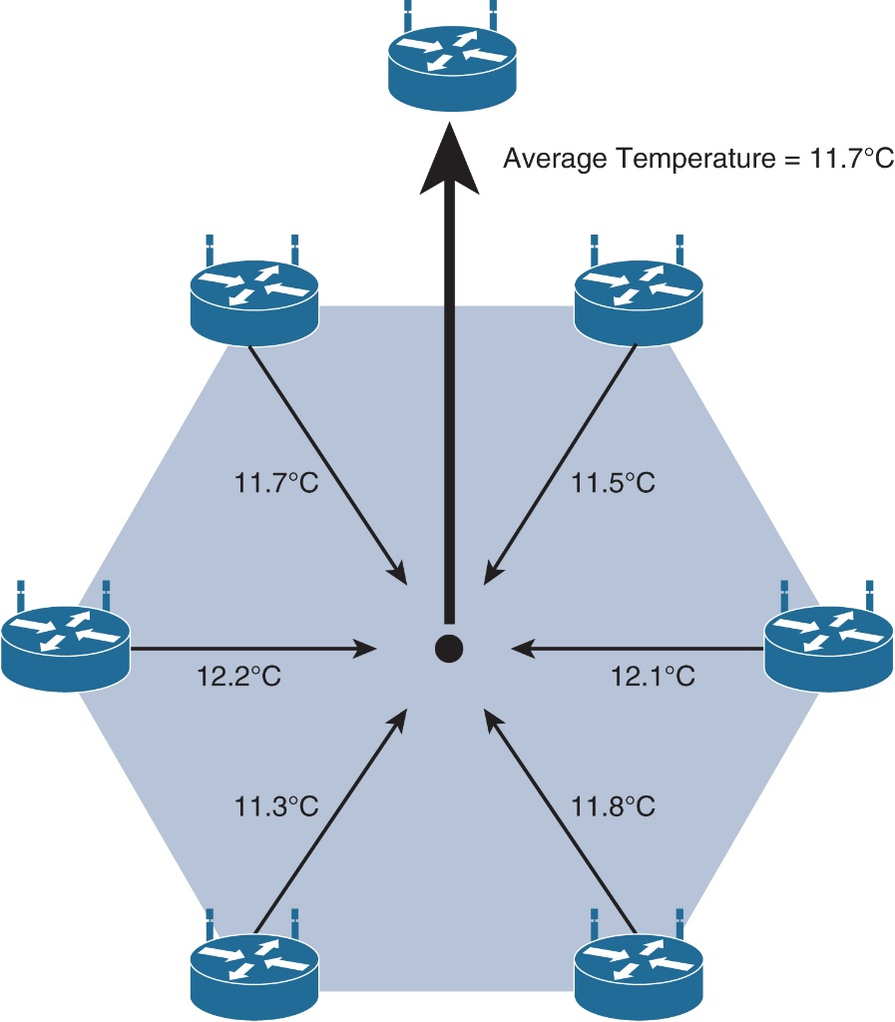
Illustration of Edge/Fog Computing: Data Aggregation in Wireless Sensor Networks

Slide 92
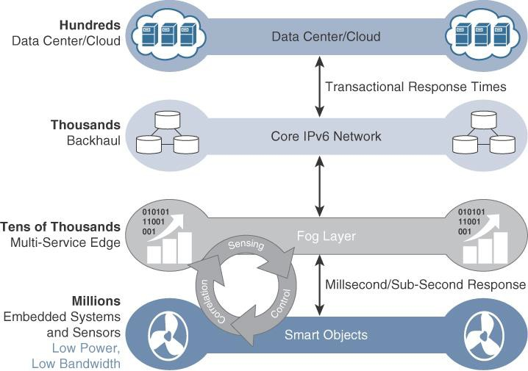
The IoT Data Management and Compute Stack with Fog
Computing

Slide 93
The defining characteristic of fog computing are as follows:
Contextual location awareness and low latency
Geographic distribution
Deployment near IoT endpoints
Wireless communication between the fog and the IoT endpoint
Use for real-time interactions

Slide 94
Edge Computing
Computing resides directly in the sensors and IoT devices.
New classes of IoT endpoints have enough compute
capabilities to perform at least low-level analytics and filtering to make basic decisions

Slide 95
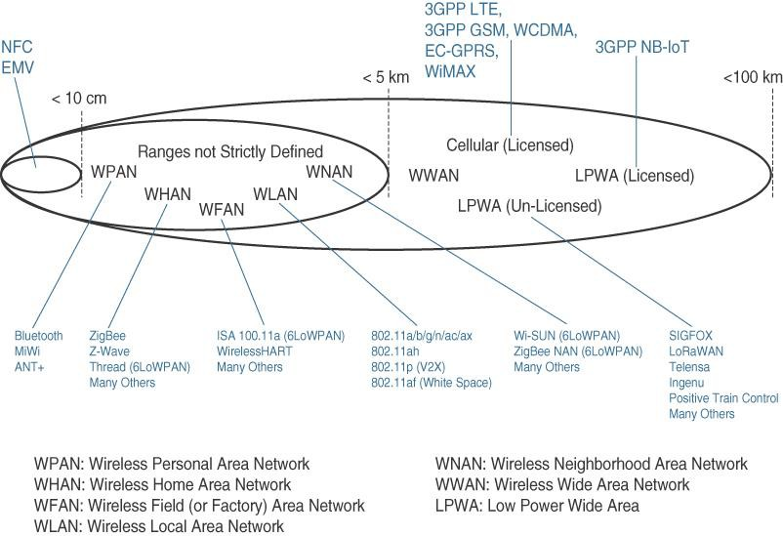
Access Technologies and Distances

Slide 96
PAN (personal area network):
Scale of a few meters.
This is the personal space around a person.
A common wireless technology for this scale is Bluetooth.
HAN (home area network):
Scale of a few tens of meters.
At this scale, common wireless technologies for IoT include ZigBee and Bluetooth Low Energy (BLE).

Slide 97
NAN (neighborhood area network):
Scale of a few hundreds of meters.
The term NAN is often used to refer to a group of house units from which data is collected.
FAN (field area network):
Scale of several tens of meters to several hundred meters.
FAN typically refers to an outdoor area larger than a single group of house units.
A FAN is sometimes viewed as a group of NANs

Slide 98
LAN (local area network):
Scale of up to 100 m.
MAN,WAN are also used
Increasing the throughput and achievable distance typically comes with an increase in power consumption
Therefore, after determining the smart object requirements (in terms of mobility and data transfer), a second step is to determine the target quantity of objects in a single collection cell, based on the transmission range and throughput required.This parameter in turn determines the size of the cell.

Slide 99
It may be tempting to simply choose the technology with the longest range and highest throughput.
However, the cost of the technology is a third determining factor
The amount of data to carry over a given time period along with correlated power consumption (driving possible limitations in mobility and range) determines the wireless cell size and structure

Slide 100
Point-to-point topologies:
These topologies allow one point to communicate with another point
Point-to-multipoint topologies:
These topologies allow one point to communicate with more than one other point.
Most IoT technologies where one or more than one gateways communicate with multiple smart objects are in this category

Slide 101
To form a network, a device needs to connect with another device.
When both devices fully implement the protocol stack functions, they can form a peer-to-peer network
However, in many cases, one of the devices collects data from the others.
For example, in a house, temperature sensors may be deployed in each room or each zone of the house, and they may communicate with a central point where temperature is displayed and controlled.
A room sensor does not need to communicate with another room sensor. In that case, the control point is at the center of the network.
The network forms a star topology

Slide 102
In such a configuration, the central point can be in charge of the overall network coordination, taking care of the beacon transmissions and connection to each sensor.
In the IEEE 802.15.4 standard, the central point is called a
coordinator for the network.
With this type of deployment, each sensor is not intended to do anything other than communicate with the coordinator in a master/slave type of relationship.

Slide 103
The sensor can implement a subset of protocol functions to perform just a specialized part (communication with the coordinator).
Such a device is called a reduced-function device (RFD).
An RFD cannot be a coordinator.
An RFD also cannot implement direct communications to another RFD.

Slide 104
The coordinator that implements the full network functions is called, by contrast, a full-function device (FFD).
An FFD can communicate directly with another FFD or with more than one FFD, forming multiple peer-to-peer connections.
Topologies where each FFD has a unique path to another FFD are called cluster tree topologies.
FFDs in the cluster tree may have RFDs, resulting in a cluster star topology.

Slide 105
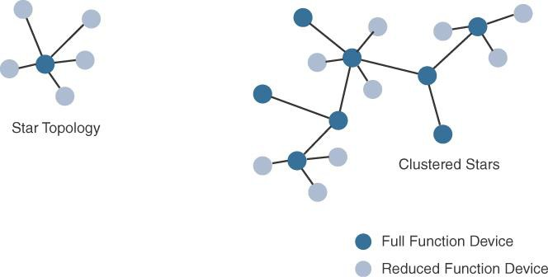
Star and Clustered Star Topologies

Slide 106
Other point-to-multipoint technologies allow a node to have more than one path to another node, forming a mesh
topology.
This redundancy means that each node can communicate with more than just one other node.
This communication can be used to directly exchange information between nodes (the receiver directly consumes the information received) or to extend the range of the
communication link.
In this case, an intermediate node acts as a relay between two other nodes

Slide 107
Another property of mesh networks is redundancy.
The disappearance of one node does not necessarily interrupt network communications.
Data may still be relayed through other nodes to reach the intended destination

Slide 108
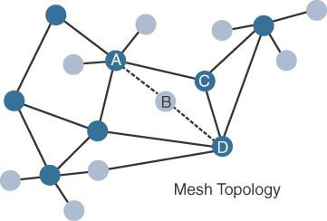
Mesh Topology

Slide 109
Gateways and Backhaul Sublayer
Data collected from a smart object may need to be forwarded to a central station where data is processed.
As this station is often in a different location from the smart object, data directly received from the sensor through an access technology needs to be forwarded to another medium (the backhaul) and transported to the central station.
The gateway is in charge of this inter-medium communication
In most cases, the smart objects are static or mobile within a limited area.
The gateway is often static
However, some IoT technologies do not apply this model

Slide 110
For example, dedicated short-range communication (DSRC) allows vehicle-to-vehicle and vehicle-to-infrastructure
communication
A wireless technology is used for backhaul communication, peer-to-peer, or mesh communication between vehicles
The choice of a backhaul technology depends on the
communication distance and also on the amount of data that needs to be forwarded.
When the smart object’s operation is controlled from a local site, and when the environment is stable (for example,
factory or oil and gas field), Ethernet can be used as a backhaul

Slide 111
In unstable or changing environments (for example, open mines) where cables cannot safely be run, a wireless technology is used.
Wi-Fi is common in this case, often with multiple hops between the sensor field and the operation center.
Mesh is a common topology to allow communication flexibility in this type of dynamic environment
However, throughput decreases as node-to-node distance increases, and it also decreases as the number of hops increases

Slide 112
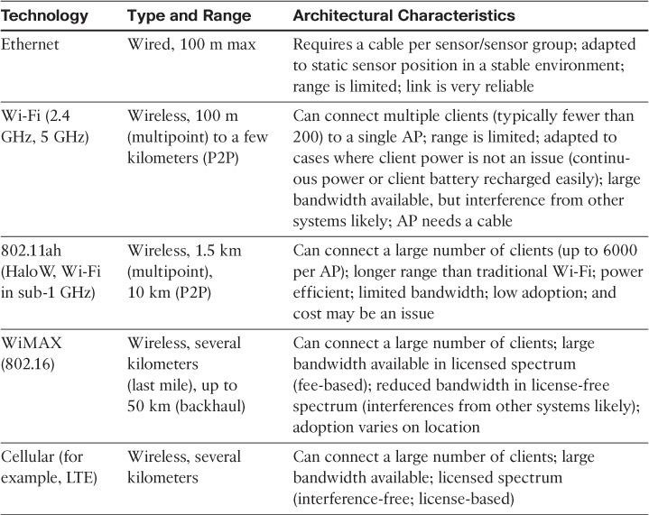
Architectural Considerations for WiMAX and Cellular Technologies

Slide 113
Network Transport Sublayer
The practical implementations are often flexible, with multiple transversal communication paths
For example, consider the case of IoT for the energy grid.
Your house may have a meter that reports the energy consumption to a gateway over a wireless technology.
Other houses in your neighborhood (NAN) make the same report, likely to one or several gateways
The data to be transported is small and the interval is large (for example, four times per hour), resulting in a low-mobility, low- throughput type of data structure, with transmission distances up to a mile
Several technologies (such as 802.11ah, 802.15.4, or LPWA) can be used for this collection segment. Other neighborhoods may also connect the same way, thus forming a FAN

Slide 114
IoT Network Management Sublayer
IP, TCP, and UDP bring connectivity to IoT networks.
Upper-layer protocols need to take care of data transmission between the smart objects and other systems
Multiple protocols have been leveraged or created to solve IoT data communication problems.
Some networks rely on a push model (that is, a sensor reports at a regular interval or based on a local trigger),
whereas others rely on a pull model (that is, an application queries the sensor over the network), and multiple hybrid approaches are also possible

Slide 115
Some IoT implementers have suggested HTTP for the data transfer phase.
The sensor could use the client part to establish a connection to the IoT central application (the server), and then data can be exchanged
But HTTP was not designed to operate in constrained environments with low memory, low power, low bandwidth, and a high rate of packet failure
One example is WebSocket.
WebSocket is part of the HTML5 specification, and provides a simple bidirectional connection over a single connection.
Some IoT solutions use WebSocket to manage the connection between the smart object and an external application

Slide 116
Extensible Messaging and Presence Protocol (XMPP)
XMPP is based on instant messaging and presence.
It allows the exchange of data between two or more systems and supports presence and contact list maintenance.
It can also handle publish/subscribe, making it a good choice for distribution of information to multiple devices

Slide 117
Constrained Application Protocol (CoAP)
CoAP uses some methods similar to those of HTTP (such as Get, Post, Put, and Delete) but implements a shorter list,
thus limiting the size of the header.
CoAP also runs on UDP (whereas HTTP typically uses TCP).
CoAP also adds a feature that is lacking in HTTP and very useful for IoT: observation.
Observation allows the streaming of state changes as they occur, without requiring the receiver to query for these changes

Slide 118
Message Queue Telemetry Transport (MQTT)
MQTT uses a broker-based architecture.
The sensor can be set to be an MQTT publisher (publishes a piece of information), the application that needs to receive the information can be set as the MQTT subscriber, and any intermediary system can be set as a broker to relay the information between the publisher and the subscriber(s).
MQTT runs over TCP

Slide 119
Layer 3: Applications and Analytics Layer
Once connected to a network, your smart objects exchange information with other systems
Analytics Versus Control Applications
Analytics application:
This type of application collects data from multiple smart objects, processes the collected data, and displays information resulting from the data that was processed
The important aspect is that the application processes the data to convey a view of the network that cannot be obtained from solely looking at the information displayed by a single smart object

Slide 120
The Hierarchy of Edge, Fog, and Cloud
It is important to stress that edge or fog computing in no way replaces the cloud
This model suggests a hierarchical organization of network, compute, and data storage resources.
At each stage, data is collected, analyzed, and responded to when necessary, according to the capabilities of the resources at each layer.
As data needs to be sent to the cloud, the latency becomes higher.
The advantage of this hierarchy is that a response to events from resources close to the end device is fast and can result in immediate benefits, while still having deeper compute resources available in the cloud when necessary.

Slide 121
It is important to note that the heterogeneity of IoT devices also means a heterogeneity of edge and fog computing resources.
While cloud resources are expected to be homogenous, it is fair to expect that in many cases both edge and fog resources will use different operating systems, have different CPU and data storage capabilities, and have different energy consumption profiles.

Slide 122
The most time-sensitive data is analyzed on the edge or fog node closest to the things generating the data.
Data that can wait seconds or minutes for action is passed along to an aggregation node for analysis and action.
Data that is less time sensitive is sent to the cloud for historical analysis, big data analytics, and long-term storage

Slide 123
In summary, when architecting an IoT network, you should
consider the amount of data to be analyzed and the time sensitivity
of this data.
Understanding these factors will help you decide whether cloud computing is enough or whether edge or fog computing would improve your system efficiency.
Fog computing accelerates awareness and response to events by eliminating a round trip to the cloud for analysis
It avoids the need for costly bandwidth additions by offloading gigabytes of network traffic from the core network.
It also protects sensitive IoT data by analyzing it inside company
walls.

